Slide 1
Object Detection From Satellite Images.

Slide 2
Group 3
Hasin Md. Daiyan
Id: 20200204055
Dept. of CSE, AUST
Amit Karmakar
Id: 20200204056
Dept. of CSE, AUST
Ahmed Al Nahian
Id: 20200204063
Dept. of CSE, AUST

Slide 3
AGENDA
1 | INTRODUCTION
2 | LITERATURE REVIEW
3 | DATASET
4 | PRE-PROCESSING TECHNIQUES
5 | MODELS
6 | RESULT & ANALYSIS
7 | CONCLUSION
8 | CONTRIBUTION

Slide 4
01
INTRODUCTION

Slide 5
Introduction
Object Detection
Object detection in Earth Vision refers to localizing objects of interest (e.g., vehicles, airplanes) on the earth’s surface and predicting their categories.
However, object detection in aerial imagery presents unique challenges due to factors such as diverse object scales, variations in lighting, atmospheric conditions,
Traditional object detection methods often struggle to adapt to these challenges, necessitating the development of advanced machine learning techniques.
In particular, deep learning approaches, have shown remarkable promise in improving detection accuracy.

Slide 6
02
Literature review

Slide 7
Literature review
Gui-Song,Xiang,Jian,Zhen,Serge,Jiebo,Mihai,Marcello,Liangpei -DOTA: A Large-scale Dataset for Object Detection in Aerial Images
Large-scale dataset with 2806 aerial images (4000 × 4000 pixels each)
188,282 object instances across 15 categories.
Dense object instances (e.g., ships in harbors, vehicles in parking lots).
Unbalanced object distribution across images.
More complex and realistic than existing aerial datasets.

Slide 8
Literature review
Bo Jiang,Ruokun Qu,Yandong Li and Chenglong Li-VC-YOLO: Towards Real-time Object Detection in Aerial Images.
Lightweight Object Detection for Aerial Images
Receptive Field Extended Backbone (RFENet) for better feature extraction
Improved feature pyramid network (iFPN) for better feature reuse across convolution stages.
Superior accuracy and efficiency on NWPU VHR-10 and VisDrone datasets

Slide 9
Literature review
Muhammed Enes ATIK, Zaide DURAN, Roni OZGUNLUK-Comparison of YOLO Versions for Object Detection from Aerial Images
Evaluated on 43 aerial images containing 9 object classes: large vehicle, small vehicle, plane, harbor, storage tank, ship, basketball court, tennis court, and swimming pool
YOLOv2 performed better in 5 out of 9 classes.
YOLOv3 excelled in detecting small objects.
Best results: YOLOv2: Airplane class with 99% F1-score
Best results: YOLOv3: Swimming pool class with 83% F1-score

Slide 10
03
Dataset

Slide 11
Dataset
DOTA
https://www.kaggle.com/datasets/chandlertimm/dota-data
DOTA is a large-scale dataset for object detection in aerial images.
Each image is of the size in the range from 800 × 800 to 20,000 × 20,000 pixels.
DOTA-v1.0 contains 15 common categories, 2,806 images and 188, 282 instances.
The proportions of the training set, validation set, and testing set in DOTA-v1.0 are 1/2, 1/6, and 1/3, respectively.

Slide 12
04
Pre-processing Techniques

Slide 13
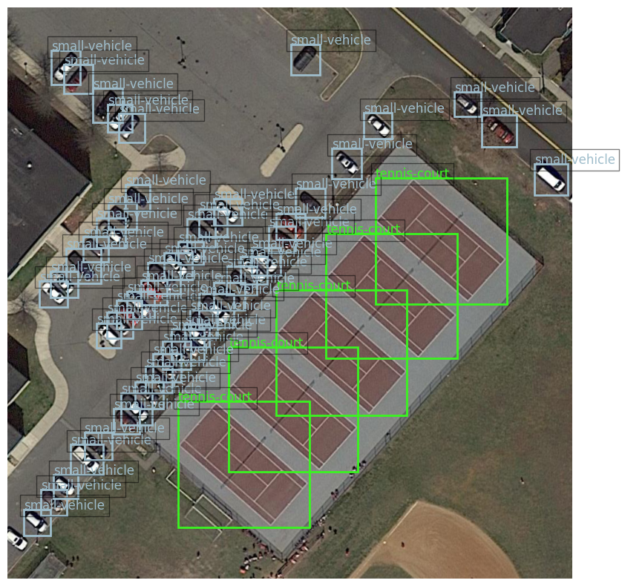
Preprocessing Techniques
Conversion to COCO Format
Initially, the dataset was
formatted into the COCO (Common Objects in Context) format.
This included generating JSON files with the necessary annotations, such as image metadata, bounding
box coordinates, and class labels

Slide 14
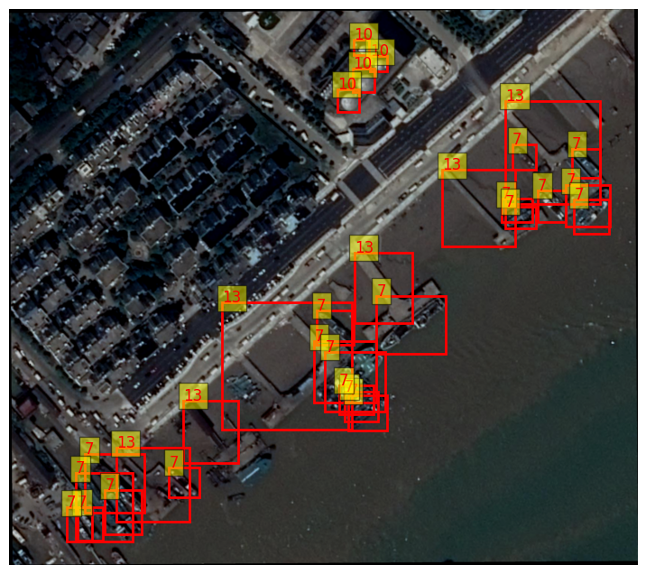
Preprocessing Techniques
Custom Dataset Implementation
A custom dataset class was created to efficiently handle the aerial images and
annotations.
This class integrated the necessary functions for loading images, parsing the annotations, and applying data augmentations such as random flips and rescaling.

Slide 15
05
Models

Slide 16
Model
1
YOLO-You Only Look Once
YOLO (You Only Look Once) is a popular object detection model known for its speed and accuracy. It was first introduced by Joseph Redmon et al. in 2016.
It processes an entire image in a single pass, making
them computationally efficient.
YOLO is a single-shot detector that uses a fully convolutional neural network (CNN) to process an image.

Slide 17
Model
2
Faster R-CNN
Faster R-CNN is another object detection model that uses region proposal networks to generate region proposals and then classifies and refines these proposals.
Faster R-CNN also requires images and bounding box annotations for training, which can be fed directly from the data loader.
Faster R-CNN is known as being a slower model than YOLO.

Slide 18
06
Result and Analysis

Slide 19
Result and Analysis (YOLO)
Class-specific performance highlights:
Tennis Court: High performance (precision: 74.6%, recall: 80.6%)
Small Vehicle: Moderate Performance.
Bridge & Helicopter: Low detection rates (0 true positives)
Overall metrics:
Precision: 68.3%
Recall: 19.3%
mAP@50: 18.8%
mAP@50-95: 10.8%
Inference Speed:
Preprocessing: 2.7 ms/image
Inference: 27.8 ms/image
Postprocessing: 13.9 ms/image
Fitness Score: 0.116 (indicates overall model effectiveness)

Slide 20
Result and Analysis (YOLO)
Based on the results, the model can be considered below average.
While it shows decent precision (68.3%), the low recall (19.3%) and mAP values (18.8% for mAP@50, 10.8% for mAP@50-95) indicate that it's missing a significant number of true positives.
Large variability in class performance—with some classes performing well (e.g., tennis court) but others poorly (e.g., bridge, helicopter)
Address Class Imbalance: More training samples for underperforming classes.

Slide 21
07
Conclusion

Slide 22
Conclusion
Aerial imagery poses unique challenges requiring advanced machine learning methods.
The dataset was converted to COCO format, a custom dataset class was implemented for data handling and augmentation, and the data was transformed to YOLO format for compatibility with object detection models.
YOLO and Faster R-CNN are two object detection models used in aerial imagery.
YOLO model demonstrates moderate precision but suffers from low recall and mean average precision, indicating a significant number of missed detections.

Slide 23
08
Contribution

Slide 24
Contribution
Hasin Md Daiyan: Writing - review & editing, Writing – Coding, Report & Presentation
Amit Karmakar : Writing - review & editing, Writing – Report & Presentation
Ahmed Al Nahian: Writing - review & editing, Writing – Coding & Report

Slide 25
Thanks!

